Slide 1
Business analytics
Session 3

Slide 2
HW and Group Projects
HW1. Graded.
HW2/Group projects. Questions? Comments?
HW3: Posted. More optimization

Slide 3
This week
Artificial Intelligence
Prescriptive Analytics
Predictive Analytics
Optimization (II, III)
Value
Diagnostic Analytics
Forecasting (I)
Descriptive Analytics
Extract, Transform, Load
Difficulty

Slide 4
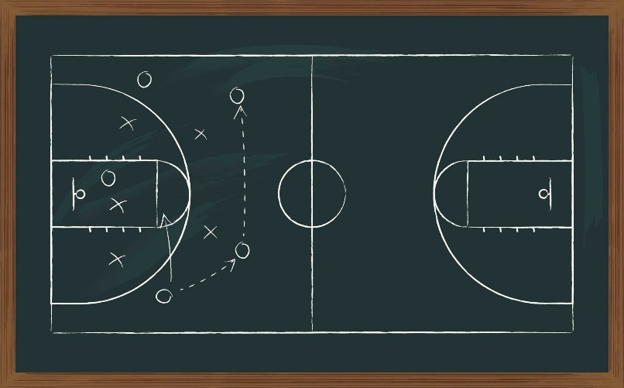
Game plan
Optimization: Integer programming
Optimization: Practice problems

Slide 5
Game plan
Optimization: Integer programming
Optimization: Practice problems

Slide 6

INTEGER LINEAR PROGRAMMING
Many (most) business decisions require integer values.
We cannot…
produce fractional numbers of products
hire fractional number of employees
sell fractional number of tickets
4

Slide 7

INTEGER LINEAR PROGRAMMING (ILP)
A problem is called Integer linear programming (ILP) problem if at least one variable must be an integer (i.e. can only take values -1, -2, 0, 1, 2,… etc)
Within ILP, we can have a model with
all integer variables,
all binary variables (0 or 1),
a mixture of continuous, binary and integer variables (MILP)
EXCEL Solver can solve ILP models; it takes longer compared to the LP model without integer restriction.
5

Slide 8
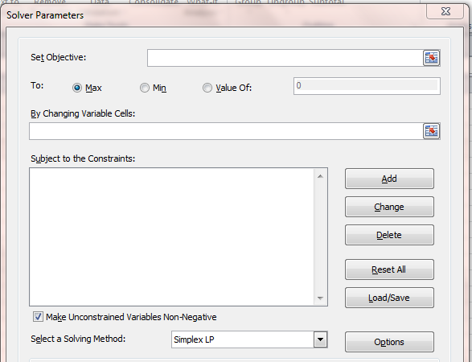
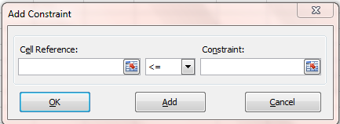
ILP with solver
Add the regular constraints: ≤ = ≥
Add integer/binary constraints: int bin

Slide 9
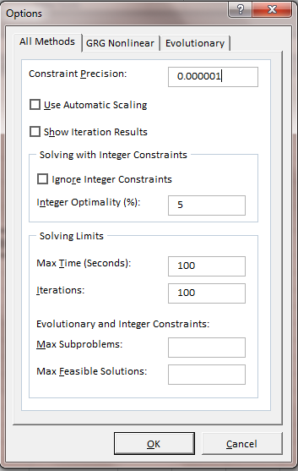
ILP with solver
Click on Options. Make sure that Ignore integer constraints box is not checked.

Slide 10
ILP with solver
We can terminate the program earlier and accept the best result obtained thus far. This may or may not be optimal.

Slide 11


ILP MODELS & APPLICATIONS
MODEL
Facility Location
Knapsack
Machine Scheduling
Set Covering
Shortest Path
Traveling Salesman
APPLICATION | COMPANY
Portfolio selection/ project selection

Slide 12
Knapsack problem
You want to fill a bag (“knapsack”) with different items to maximize value of the goods you are carrying.
There are n types of items you can put in your “knapsack” and there is a weight limit.

Slide 13

Knapsack Problem
Project | 1 | 2 | 3 | 4 | 5
Net Present Value (NPV) | $10 | $17 | $16 | $8 | $14
Expenditure | $48 | $96 | $80 | $32 | $64
You have a budget of 176 million dollars. Which projects should we select to maximize NPV? Assume each project can only be chosen once.

Slide 14
Knapsack Problem: GAP
Define Model in Words
O: Objective
D: Decision Variables
C: Constraints
Formulate Model Mathematically
D: Define Decision Variables
O: Define Objective Function in terms of Decision Variables
C: Define Constraints in terms of Decision Variables
)
(Maximize NPV)
(Which projects to Select)
(Each project can only be selected once,
Total expenditure cannot exceed budget)
(P1, P2, P3, P4, P5 equals 1 if selected )
($10 * P1 + $17 * P2 + $16 * P3 + $8 * P4 + $14 * P5)
(P1, P2, P3, P4, P5 are binary (must be 0 or 1))
($48 * P1 + $96 * P2 + $80 * P3 + $32 * P4 + $64 * P5 <= $176)

Slide 15

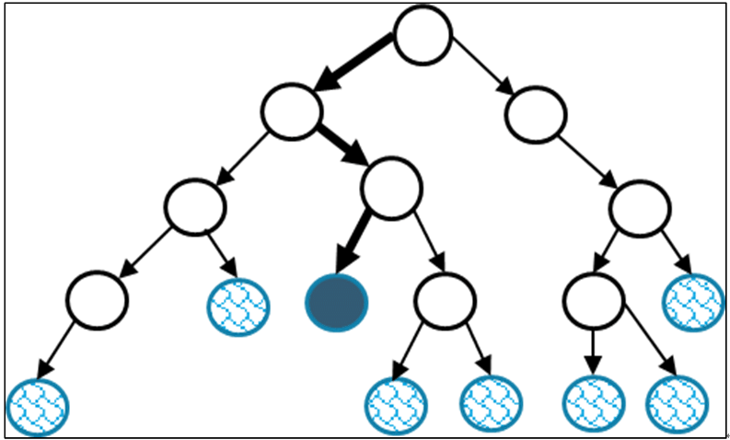
Under the Hood: Branch and Bound
When the Simplex LP or GRG Nonlinear Solving methods are used to solve ILPs, Solver uses the Branch & Bound algorithm.
A branch & Bound algorithm is a systematic enumeration of candidate solutions.
The algorithm starts with a “root” node of a tree and explores branches of this tree, which are subsets of the solution set.

Slide 16
Under the Hood: Branch and Bound
y
9
Maximize | P(rofit) = 7x + 11y
Subject to | x + y ≤ 6 18x + 34y ≤ 154
What if x and y must be integers?
8
7
Optimal ILP: x = 1, y = 4, P = 51
6
Optimal LP: x = 3.13, y = 2.88, P = 53.5
5
4
Try Four Closest Integer Points
Point | P(rofit)
3
(3,3)
Infeasible
2
(4,3)
Infeasible
1
(3,2)
43
1
2
3
4
5
6
7
8
9
(4,2)
50
x

Slide 17





Under the Hood : Branch and Bound
y
Root node
LP: P = 53.5
(3.13, 2.88)
9
Maximize | P = 7x + 11y
Subject to | x + y ≤ 6 18x + 34y ≤ 154
8
7
y ≤ 2
y ≥ 3
6
LP: P = 50
(4, 2)
LP: P = 52.22
(2.89, 3)
5
4
P = 51
x ≤ 2
x ≥ 3
3
P = 47
LP: P = 52.18
(2, 3.47)
Infeasible!
2
1
P = 50
y ≤ 3
y ≥ 4
1
2
3
4
5
6
7
8
9
x
LP: P = 47
(2, 3)
LP: P = 51
(1, 4)

Slide 18
Game plan
Optimization: Integer programming
Optimization: Practice problems
Network problems (LP)
Other integer problems (ILP)

Slide 19
Special types of LP problems
“Product mix” problems Allocate scarce production resources to product types (Usually Max)
“Network” problems Find most efficient way from source(s) to destination(s) (Usually Min)
“Covering/staffing/scheduling” problems Minimize cost while ensuring minimum requirements (Usually Min)
“Blending” problems Like covering but with proportionality constraints (Usually Min)

Slide 20

5
Notes:
https://www.dropbox.com/s/0xipeltv1rry5dg/goodwill.mov?dl=0

Slide 21



Network problems
“Network” problems Find most efficient way from source(s) to destination(s) (Usually Min)
C
A
D
A
2H
3H
1H
2H
D
2H
B
E
1H
3H
B
3H
2H
E
C
F

Slide 22




Google ads
“Vote Dog Party”, 35 ads
“Carey Part-Time Degrees”, 50 ads
“Save the Bees”, 40 ads

Slide 23
Google’s dilemma
Supply: The following number of ads has been prepaid by the advertisers:
“Vote Dog Party”: 35 ads
“Carey Part-time degrees”: 50 ads
“Save the Bees”: 40 ads
Demand: Based on past browsing behavior Google has identified that the following three users are exposed to at least the following number of ads:
Joe: 40 ads
Pat: 20 ads
Mel: 40 ads

Slide 24
Network LP Problem
Relative interest/fit (0: low, 100: high)
 | Joe | Pat | Mel | Supply
Vote Dog Party (VD) | 80 | 60 | 60 | 35
Carey Part-Time Degrees (CD) | 90 | 10 | 10 | 50
Save the Bees (SB) | 15 | 90 | 80 | 40
Demand | 40 | 20 | 40
Your Task
Ads
Users
How many ads of each type should be shown to each user to maximize total/aggregate fit between ads and users’ interests?
VD
Joe
CD
Pat
SB
Mel

Slide 25
Network LP Problem: GAP
Define Model in Words
O: Objective
D: Decision Variables
C: Constraints
Formulate Model Mathematically
D: Define Decision Variables
O: Define Objective Function in terms of Decision Variables
C: Define Constraints in terms of Decision Variables
(Maximize total interest/fit)
(number of ads of each type shown to each user)
(Each user receives the required minimum of ads, each advertiser has prepaid for the required number of ads)
9 variables: VDJ, VDP, VDM,CDJ, CDP, CDM, SBJ, SBP, SBM
(80 * VDJ + 60 * VDP + 60 * VDM + 90 * CDJ + 10 * CDP + 10 * CDM + 15 * SBJ + 90 * SBP + 80 * SBM)
(Next Slide)

Slide 26
Network LP Problem: GAP
Supply Constraints:
VD Supply: VDJ + VDP + VDM <= 35
CD Supply: CDJ + CDP + CDM <= 50
SB Supply: SBJ + SBP + SBM <= 40
Demand Constraints:
Joe Demand: VDJ + CDJ + SBJ >= 40
Pat Demand: VDP + CDP + SBP >= 20
Mel Demand: VDM + CDM + SBM >= 40
Integrality Constraints:
VDJ, VDP, VDM,CDJ, CDP, CDM, SBJ, SBP, SBM all integer

Slide 27


Slide 28
Game plan
Optimization: Integer programming
Optimization: Practice problems
Network problems (LP)
Other ILPs

Slide 29
NETWORK MODELS & APPLICATIONS
MODEL
Facility Location
Knapsack
Machine Scheduling
Set Covering
Shortest Path
Traveling Salesman
APPLICATION | COMPANY
Portfolio selection/ project selection

Slide 30
NETWORK MODELS & APPLICATIONS
MODEL
Facility Location
Knapsack
Machine Scheduling
Set Covering
Shortest Path
Traveling Salesman
APPLICATION | COMPANY
Portfolio selection/ project selection
Supply chain design

Slide 31
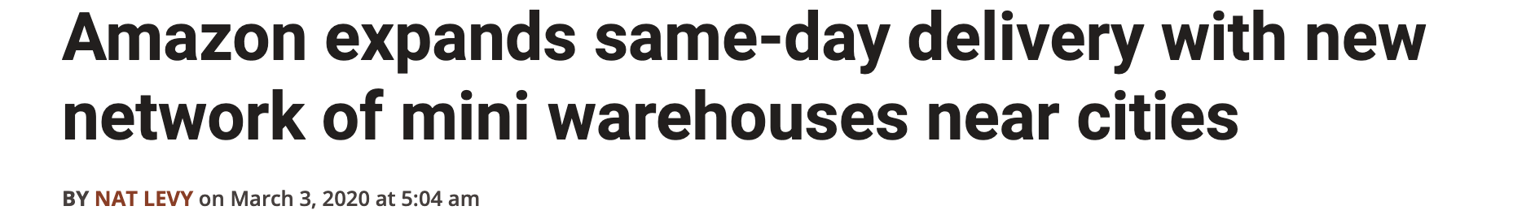
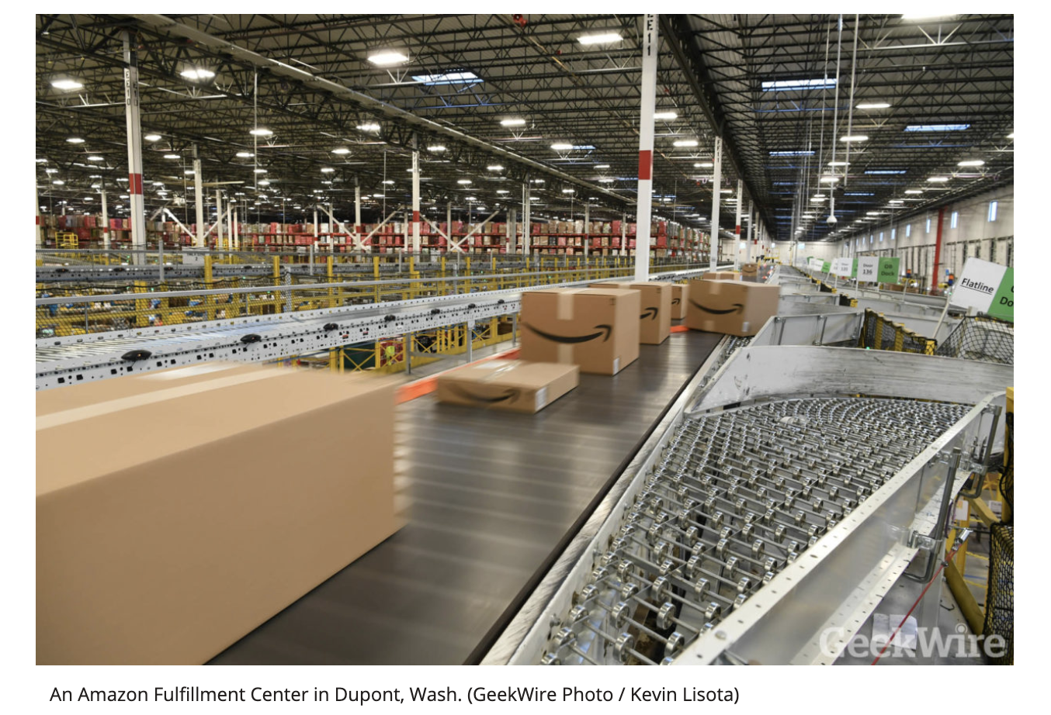
Set covering: Amazon

Slide 32
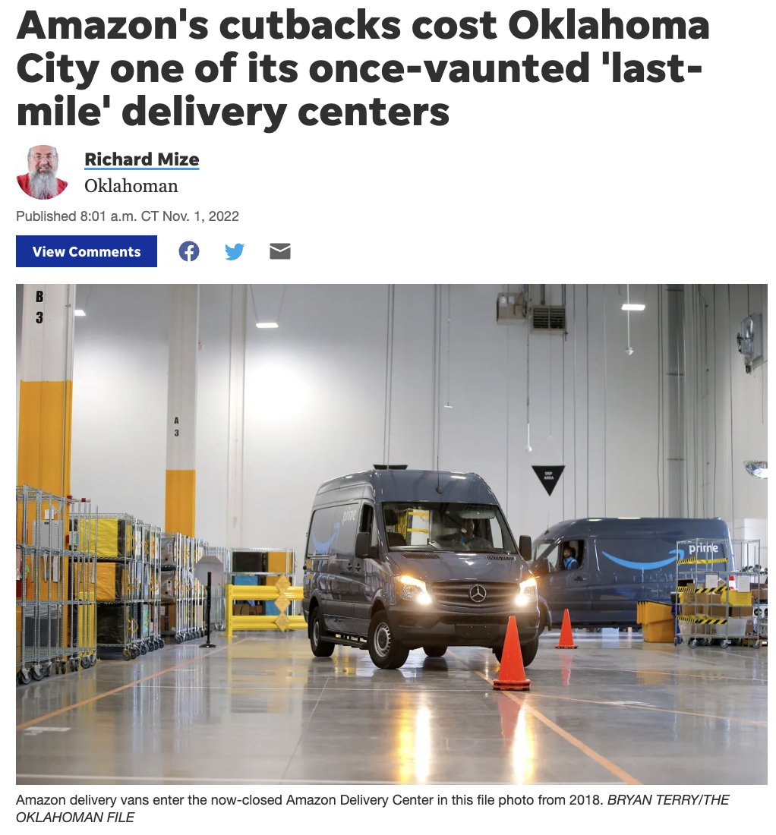
Set covering: Amazon

Slide 33
Network design (Set covering problem)
Amazon is planning to roll out same day delivery to 9 Cities: C1, C2,.., C9
C1
*
C9
*
C2
*
L2
●
L1
●
Seven distribution center locations (L1, L2, …, L7) have been identified as potential locations.
L3
●
L7
●
C3
*
C8
*
L6
●
L4
●
L5
●
C4
*
Not all cities can be reached from all potential locations within the same day.
C7
*
C6
*
C5
*

Slide 34
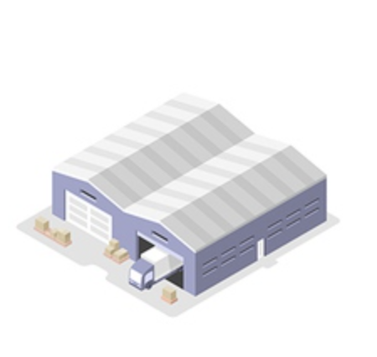
Network design (Set covering problem)
City | Can be reached from
C1 | L2, L4, L7
C2 | L1, L6, L7
C3 | L2, L6, L7
C4 | L2, L3, L5, L6
C5 | L1, L3, L5
C6 | L1, L4, L6
C7 | L1, L7
C8 | L3, L4, L5
C9 | L1, L5
Determine which locations should be selected as new distribution centers to cover all cities with minimum number of distribution centers

Slide 35
Set Covering Problem: GAP
Define Model in Words
O: Objective
D: Decision Variables
C: Constraints
Formulate Model Mathematically
D: Define Decision Variables
O: Define Objective Function in terms of Decision Variables
C: Define Constraints in terms of Decision Variables
(Minimize Distribution Center Sites)
(Which locations to build sites on)
(Each city must be covered by at least one site,
Each location can have at most one site)
(L1, L2, L3, L4, L5, L6, L7 as binary (0,1))
MIN (L1 + L2 + L3 + L4 + L5 + L6 + L7)
(See next slide)

Slide 36
Set Covering Problem: GAP Constraints
City | Can be reached from
C1 | L2, L4, L7
C2 | L1, L6, L7
C3 | L2, L6, L7
C4 | L2, L3, L5, L6
C5 | L1, L3, L5
C6 | L1, L4, L6
C7 | L1, L7
C8 | L3, L4, L5
C9 | L1, L5
Constraint
L2 + L4 + L7 >= 1
L1 + L6 + L7 >= 1
L2 + L6 + L7 >= 1
L2 + L3 + L5 + L6 >= 1
L1 + L3 + L5 >= 1
L1 + L4 + L6 >= 1
L1 + L7 >= 1
L3 + L4 + L5 >= 1
L1 + L5 >=1
(L1, L2, L3, L4, L5, L6, L7 are binary (must be 0 or 1))

Slide 37

Set Covering Problem: Multiple Solutions
Multiple Solutions: The minimum number of sites is three. However, there are 8 optimal solutions. Open locations:
1, 2, 3
1, 2, 4
1, 2, 5
1, 3, 7
1, 4, 6
1, 5, 7
4, 5, 7
5, 6, 7

Slide 38



Matching/Assignment problems
Matching/Assignment problems: Many business decisions involve matching/assigning. For example:
Assigning patients to doctors
Assigning workers to tasks/projects
Matching users with other users

Slide 39
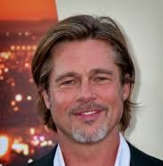

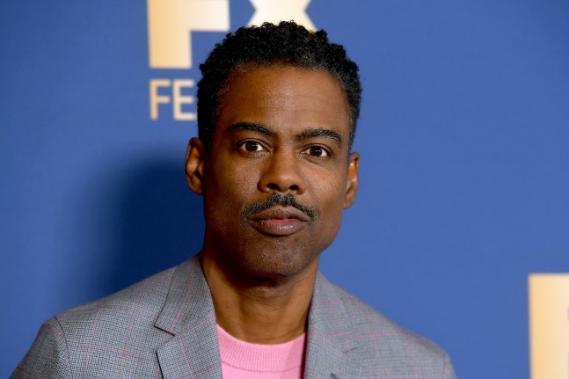
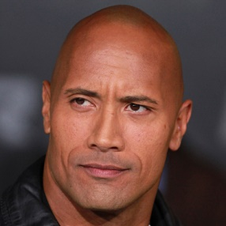


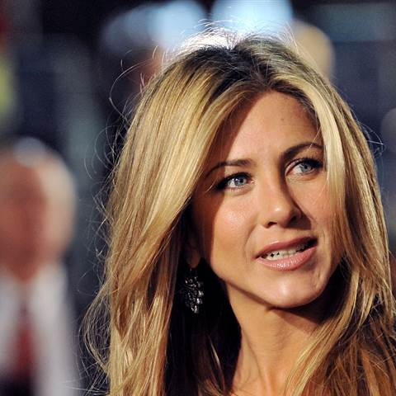
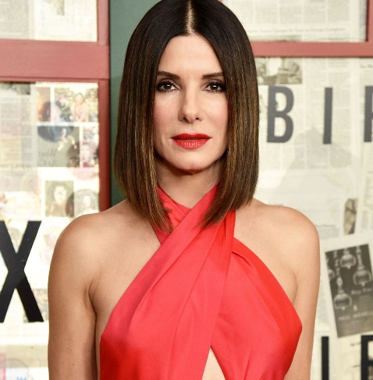
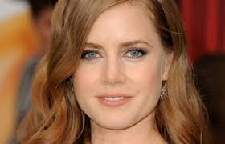
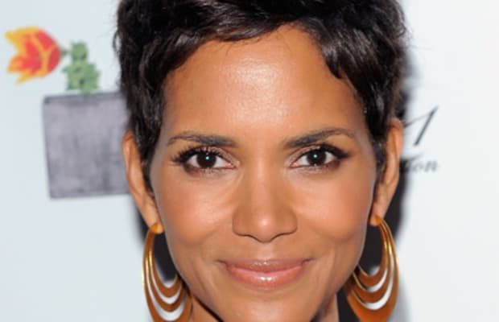
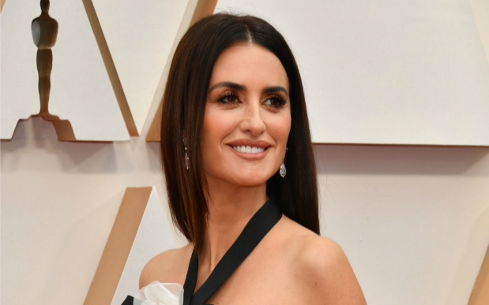
Stardust Inc

Slide 40
Stardust Inc
Stardust Inc, is a new matching service that promises more meaningful match-making through enhanced data analytics. In preparation for the company’s first product launch, you have been hired to conduct several match-making pilots with user groups in the LA Beverly Hills area.
Stardust has surveyed 10 power users (5 male and 5 female) about their enjoyment of the following categories.
Watching movies (1: min, 10:max)
Meditation (1: min, 10:max)
Dogs (1: min, 10:max)
Pumpkin spiced lattes (1: min, 10:max)
Your task is to match the users to maximize the fit in interests of each matched pair. Note that at this point Stardust matches male with female users only (not male with male or female with female).

Slide 41
Stardust INC: User responses
User | Gender | Movies | Meditation | Dogs | PSL
Brad Pitt (B) | M | 7 | 4 | 5 | 2
Tom Cruise (T) | M | 5 | 3 | 5 | 7
Mark Wahlberg (M) | M | 2 | 7 | 3 | 5
Chris Rock (C) | M | 8 | 2 | 4 | 2
Dwayne Johnson (D) | M | 6 | 4 | 2 | 8
Jennifer Aniston (J) | F | 2 | 5 | 2 | 1
Halle Berry (H) | F | 8 | 5 | 1 | 7
Amy Adams (A) | F | 6 | 2 | 2 | 4
Penélope Cruz (P) | F | 7 | 2 | 6 | 1
Sandra Bullock (S) | F | 8 | 2 | 5 | 8

Slide 42

Break Outs
1. (Attempt to) solve the two problems:
Amazon facility location (supply chain design problem)
Stardust (matching/assignment problem)
Choose a spokesperson for your team to present results
Notes:
Group 1: https://docs.google.com/document/d/1a0icpaX4tDlTI5ExnIdIDtNp0JdrzOZlOytmcgcnks4/edit?usp=sharing
Group 2: https://docs.google.com/document/d/1i_2wm36vfPnGJz1Ly9hNB3SDuRqgU6bpKQjsPhEh7Z0/edit?usp=sharing
Group 3: https://docs.google.com/document/d/18jiDrLmY10seRUrmRyLcy7pKkztN08r6jANm1UB8dOQ/edit?usp=sharing
Group 4: https://docs.google.com/document/d/1gUM5GZy9FZaK2Tw-Ji9LU_0QzbS8DNEBRIneLUXnKbo/edit?usp=sharing
Group 5: https://docs.google.com/document/d/1UM93QmixtR7VrBYeZ1Lt3FSooE-JPW-z9VPTJtGZVPU/edit?usp=sharing
Group 6: https://docs.google.com/document/d/1MNUm2OfHn_l4EJAH8bzkX1n8X7KXGw7hoe_nXBX774Q/edit?usp=sharing
Group 7: https://docs.google.com/document/d/1Cnyb_TMr9DzkQVkyUHvFz6LllP8zu4d_HkdVt_EQGck/edit?usp=sharing
Group 8: https://docs.google.com/document/d/1TX2PiXSdbmJSjg3M42Kd25z3ge04XIZdLNUl9QqIVYU/edit?usp=sharing
Group 9: https://docs.google.com/document/d/1GBl3HjA7kUS1hrexrqSV0J4Gb1jXJHEU0VoAT5aOjqQ/edit?usp=sharing
Group 10: https://docs.google.com/document/d/1zWnlJWgfz8xmZNUK7qLK5snXzfa5rb_ZlmmpCWq0uvs/edit?usp=sharing
Group 11: https://docs.google.com/document/d/1i-BLov-zPh9I8cV4cKxxKxi-1Ln8oLNAv03F7HW8GF8/edit?usp=sharing

Slide 43
Stardust INC: Pre-GAP
Step 0 (Pre-GAP): Define a dis/similarity metric and calculate it for each pair.
Possible metric: average of the absolute difference in enjoyment of different categories. For example, let M_BJ be the dissimilarity metric for Brad Pitt (B) and Jennifer Aniston (J):
M_BJ = |B’s score for movies – J’s score for movies| +
|B’s score for meditation – J’s score for meditation| +
|B’s score for dogs – J’s score for dogs| +
|B’s score for PSL – J’s score for PSL|
= |7-2| + |4-5| + |5-2| + |2-1| = 5 + 1 + 3 + 1 = 10
Brad Pitt (B) | M | 7 | 4 | 5 | 2
Jennifer Aniston (J) | F | 2 | 5 | 2 | 1

Slide 44
Stardust: GAP
Define Model in Words
O: Objective
D: Decision Variables
C: Constraints
Formulate Model Mathematically
D: Define Decision Variables
O: Define Objective Function in terms of Decision Variables
C: Define Constraints in terms of Decision Variables
(Maximize total value of matches/Minimize differences)
(Which celebrities to match together)
(Each male celebrity must be matched with exactly one female celebrity and vice versa)
(BJ: Brad and Jennifer are matched or not, BK: Brad and S matched or not, … etc) – 25 total, for each possible match
MIN (36 * BJ + 43 * BS + …. + M_MP * MP)
(See next slide)

Slide 45
Stardust: GAP
Constraints:
Each male celebrity gets a match (5 constraints)
BJ + BH + BA + BP + BS = 1 (For B. Pitt)
TJ + TH + TA + TP + TS = 1 (For T. Cruise)
…etc
Each female celebrity gets a match (5 constraints)
BJ + TJ + MJ + CJ + DJ = 1 (For J. Aniston)
BH + TH + MH + CH + DH = 1 (For H. Berry)
…etc
Each match variable is binary (0-1):
BJ, BH, BA, BP, BS, TJ, TH, TA, TP, TS, MJ, MH, MA, MP, MS, CJ, CH, CA, CP, CS, DJ, DH, DA, DP, DS all binary

Slide 46

Midterm Feedback

Slide 47
Next week
Artificial Intelligence
Prescriptive Analytics
Predictive Analytics
Optimization (II, III) Risk modeling (IV, V)
Value
Diagnostic Analytics
Forecasting (I)
Descriptive Analytics
Extract, Transform, Load
Difficulty

